Slide 1
Where should an entrepreneur open an Italian cuisine restaurant, considering seaside resorts in western coast of Poland?
Author: Agnieszka Kania

Slide 2
Why is this topic of interest?
polish seaside towns have significantly developed in terms of holiday housing for rent
trend on housing market has been followed by development of local venues
not clear if the market is already saturated and if so – where
reading through available research is a ‚must’ to make data-driven investment decisions
Who is the target audience of the project?
entrepreneurs searching for the best resorts to invest in
capital funds, venture capitalists or business angels, who invest private money into businesses

Slide 3
What are the factors which will affect an investment decision?
When thinking where to locate an Italian restaurant one needs to think about, among other things:
number of nearby restaurants,
their cuisine type/profile,
their geospatial distribution in selected towns
Features of a place which is good to open a new restaurant:
does not have a neighboring restaurant of the same cuisine type in range of 15km.
it should be in a "food-serving" zone of the town so it's easily accessible to people.
If an Italian restaurant in certain town doesn’t exist, this town should be considered a 'golden spot' location

Slide 4
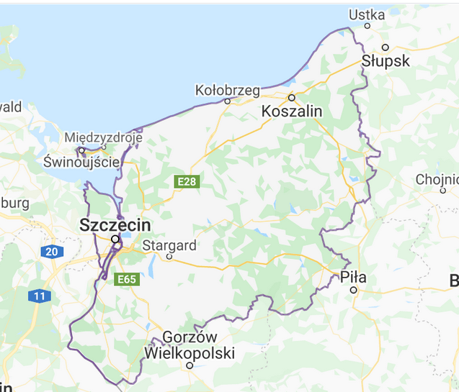
Which seaside resorts will be considered?
8
Świnoujście
Międzyzrdoje
Dziwnów
Rewal
Kołobrzeg
Ustronie Morskie
Mielno
Darłowo
5
6
7
3
4
1
2

Slide 5
What do we know about the towns?
Town | Population | Area [km^2] | All restaurants | Italian restaurants
1. Świnoujście | 40 883 | 197.0 | 8 | 0
2. Międzyzrdoje | 5 417 | 4.5 | 3 | 1
3. Dziwnów | 2 717 | 4.9 | 0 | 0
4. Rewal | 984 | 4.1 | 1 | 0
5. Kołobrzeg | 46 830 | 25.7 | 10 | 1
6. Ustronie Morskie | 3 658 | 57.0 | 1 | 0
7. Mielno | 5 068 | 33.5 | 2 | 0
8. Darłowo | 14 931 | 20.21 | 0 | 0

Slide 6
How does it look in reality?
Next few pages present geospatial distribution of the venues, including the italian and other restaurants, in each seaside town.

Slide 7
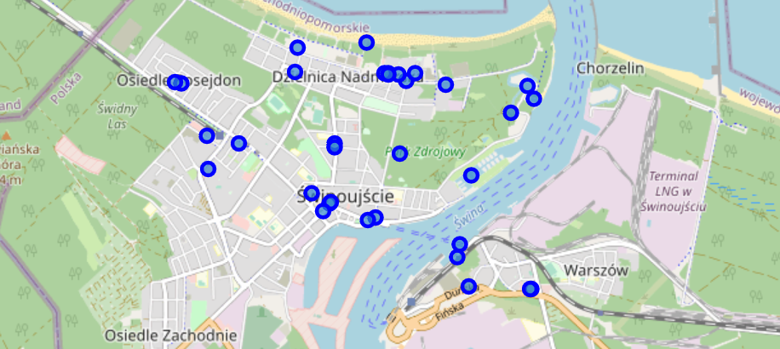
Map of Świnoujście
All Venues

Slide 8
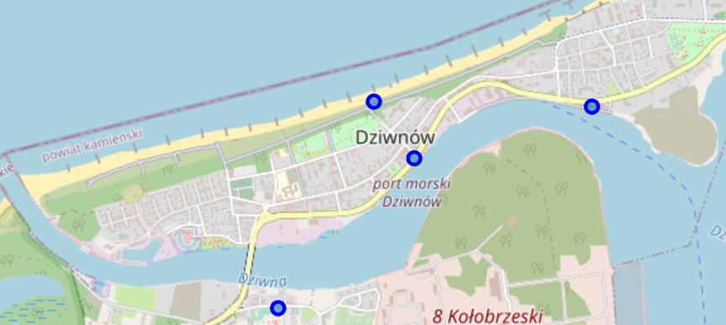
Map of Dziwnów
All Venues, no restaurants

Slide 9
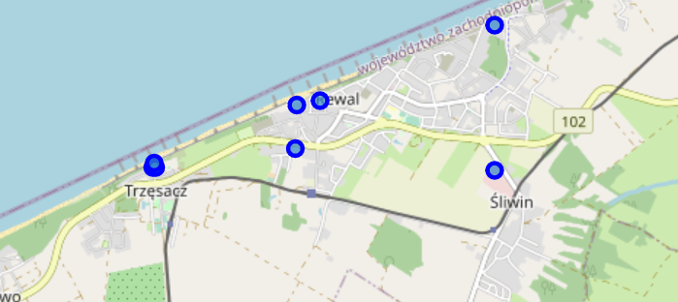
Map of Rewal
All Venues

Slide 10
Map of Rewal
All Venues

Slide 11
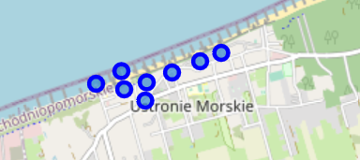
Map of Ustronie Morskie
All Venues

Slide 12
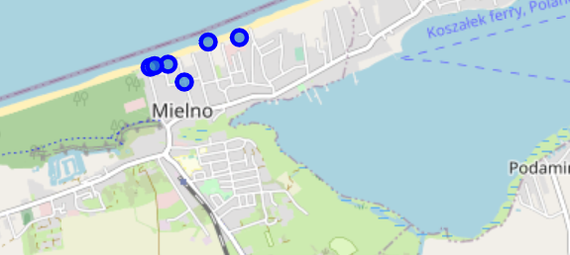
Map of Mielno
All Venues

Slide 13
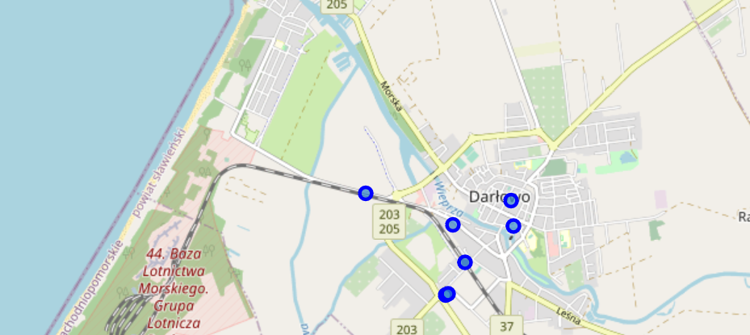
Map of Darłowo
All Venues, no restaurants

Slide 14
Results
Surprisingly, only in 2 out of the 8 towns there exists an Italian cuisine restaurant.
And only 6 out of 8 have restaurants at all. Towns without restaurant may not be the best for a start.
We’re left with 4 towns to consider. Considering the total population of each of towns, it is advisable to start a business in a relatively big one, to have enough potential customers to live on. By far Świnoujście is the best choice.
Town | Population | Area [km^2] | All restaurants | Italian restaurants
1. Świnoujście | 40 883 | 197.0 | 8 | 0
2. Międzyzrdoje | 5 417 | 4.5 | 3 | 1
3. Dziwnów | 2 717 | 4.9 | 0 | 0
4. Rewal | 984 | 4.1 | 1 | 0
5. Kołobrzeg | 46 830 | 25.7 | 10 | 1
6. Ustronie Morskie | 3 658 | 57.0 | 1 | 0
7. Mielno | 5 068 | 33.5 | 2 | 0
8. Darłowo | 14 931 | 20.21 | 0 | 0

Slide 15
Conclusion and further developments
Based on the above analysis, an entrepreneur should open an Italian cuisine restaurant in Świnoujście, a seaside resort in western coast of Poland, by the Baltic sea.
It could be beneficial to consider data which will be collected from a newly opened places.
Introducing a starting date of a venue to the dataset, could allow modelling of real success or failures of specific kinds of restaurants in certain locations.
A similar code could be used to analyse situation in central-eastern seaside resort
It could be interesting to join in the data from Statistical Office about tourism in each of the towns. This could feed into the discussion of how to shape the business in terms of scaling up during summer or down in winter months.

Slide 16
Bibliography
Data about seaside resorts: wikipedia.com

